Slide 1
ACM 476
Enes YILDIRIM - 20211603001
Demir SARRAÇ - 20231603050

Slide 2

Where should we look?

Slide 3
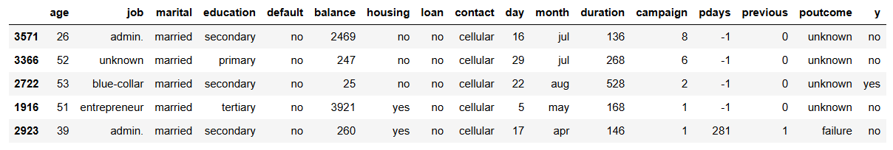
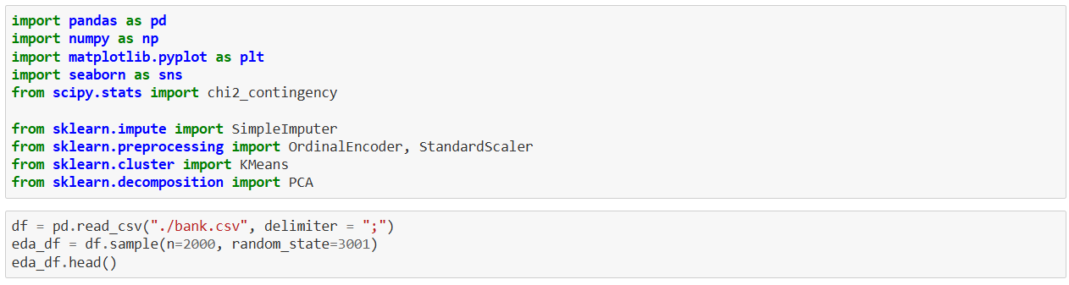
Basis of Inferences

Slide 4
COLUMNS
Age: Numeric, continious
Job: Categorical, should be learnt how many unique job are there and using skleran.OneHotEncoder we should make this column numeric 1
Marital: Categorical
Education: Categorical but also ordinal. Education can be unknown,secondary,primary, or tertiary. To make it more reasonable, we'll replace "unknown" with NaN and then fill them with mode. And then, using OrdinalEncoder we make this column ordinal.
Default: Categorical,
Balance: Numeric, continious. Since there are many rich people, we may need to normalize this feature.
Housing: Categorical
Loan: Categorical
Contact: Categorical, communication type
Day: Numeric, day of the month of last contact. We may drop tihs column, but first, we should see whether is there a correlation between day and y or not
Month: Categorical, we may drop this column.
Duratin: Numeric, duration of the last contact in seconds. We may want to drop this column too, there might be a data leakage, which makes our model working exceptionally.
Campaign: Numeric
Pdays: Numeric, days since the client was las contacted (1 means never contacted before). We may need to create a feature called isContacted to make#### 1 values more meaningful.
Previous: Numeric, number of previous contacts before this campaign.
Poutcome: Categorical, outcome of the previous marketing campaign. This can be unknown, failure, success. We may replace unknown with NaN an then fill this blanks with the mode.
y: Categorical, has the client subscribed to a term deposit? The feature we're trying to predict.

Slide 5
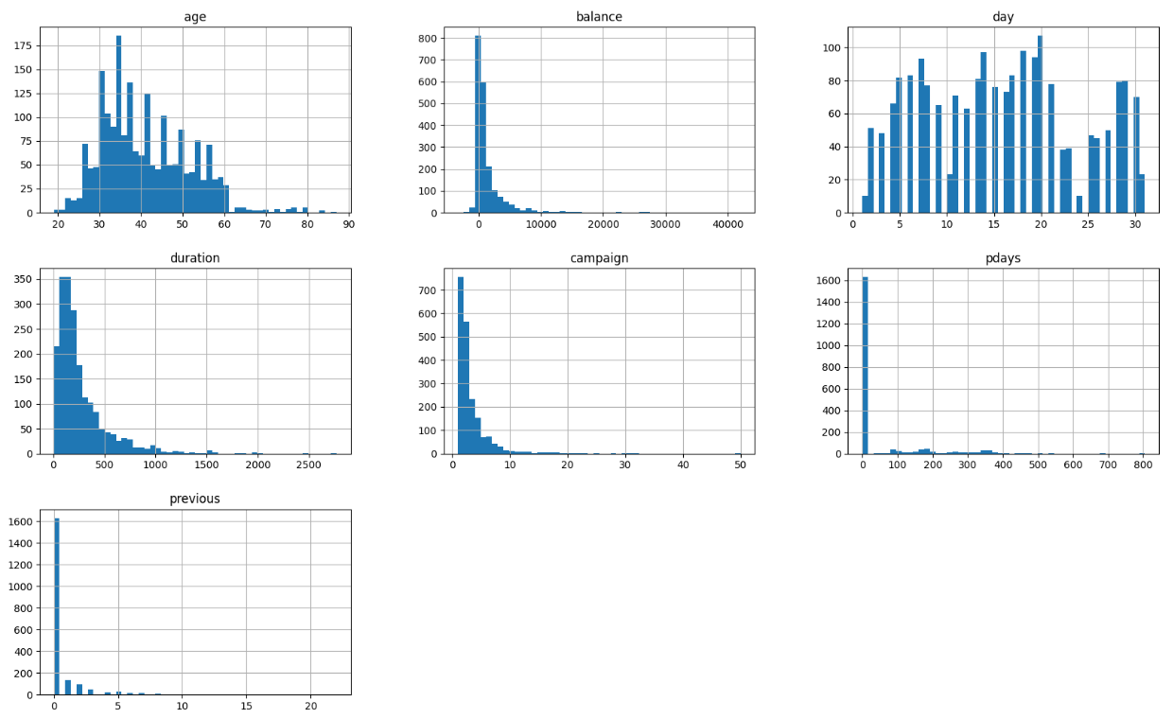
There are no missing values in our data. If there were missing values, we would use

Slide 6
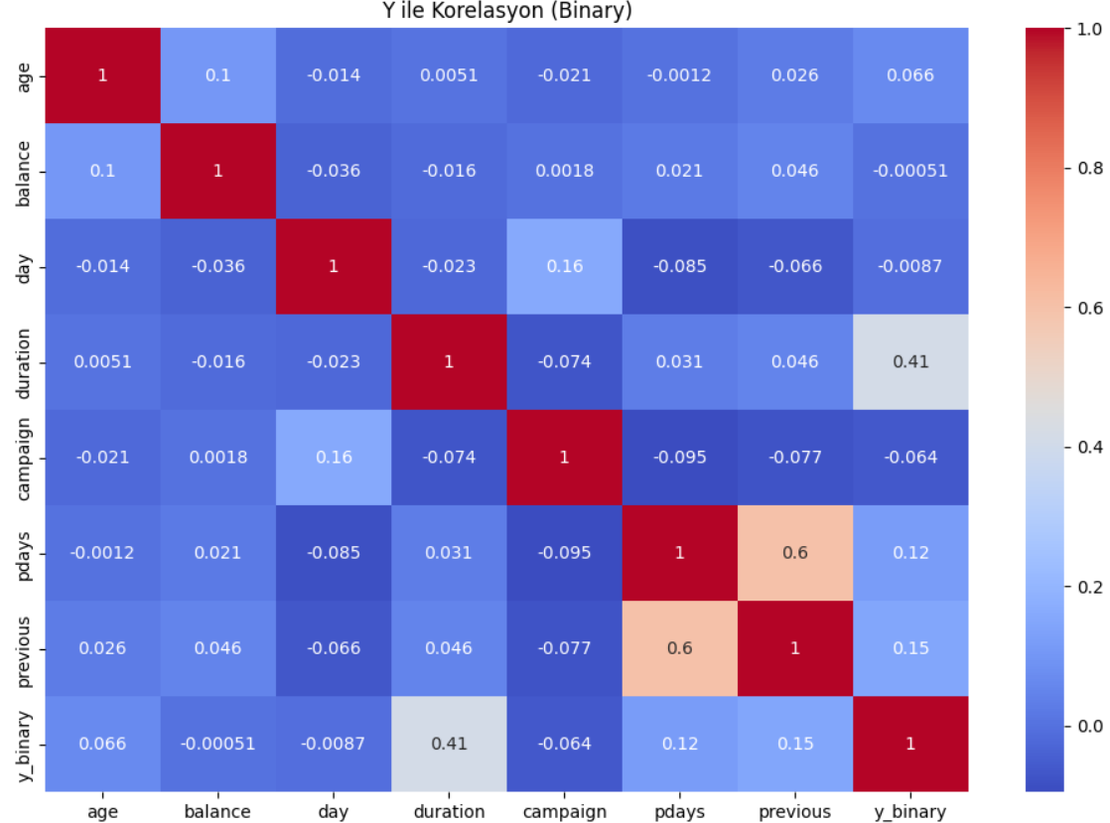
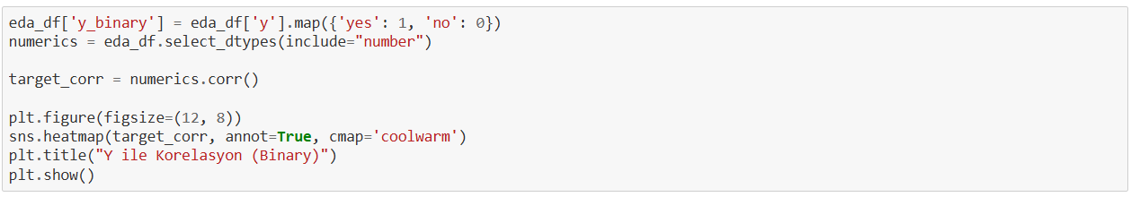
As we said earlier, there is a exceptionally high correlation between duration and y. Possibly it is a data leakage, which we should avoid.

Slide 7
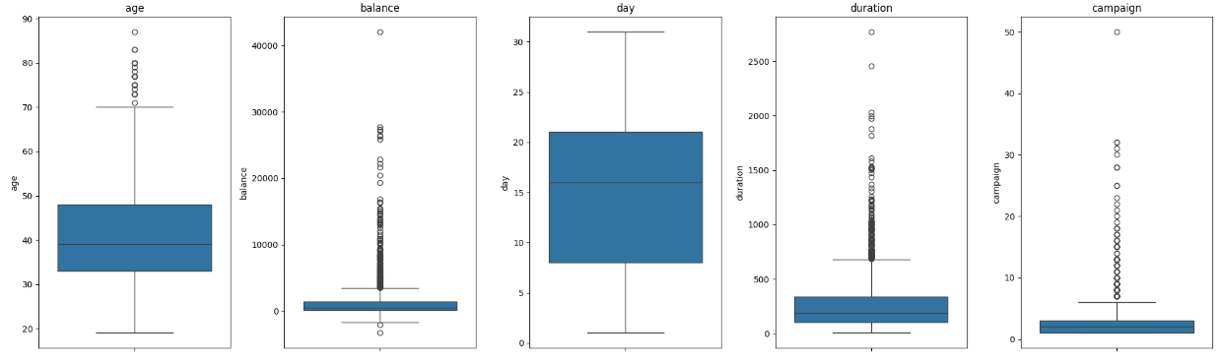
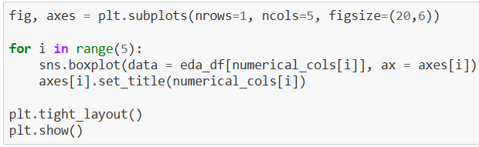
In age and campaign columns, the medians are almost in the middle. There are outliers in these columns, but comparing to balance column, they are less than balance column.
Balance and duration columns have short whiskers and numerous outliers. That means these columns are imbalanced. So, we'll use StandardScaler [1]

Slide 8
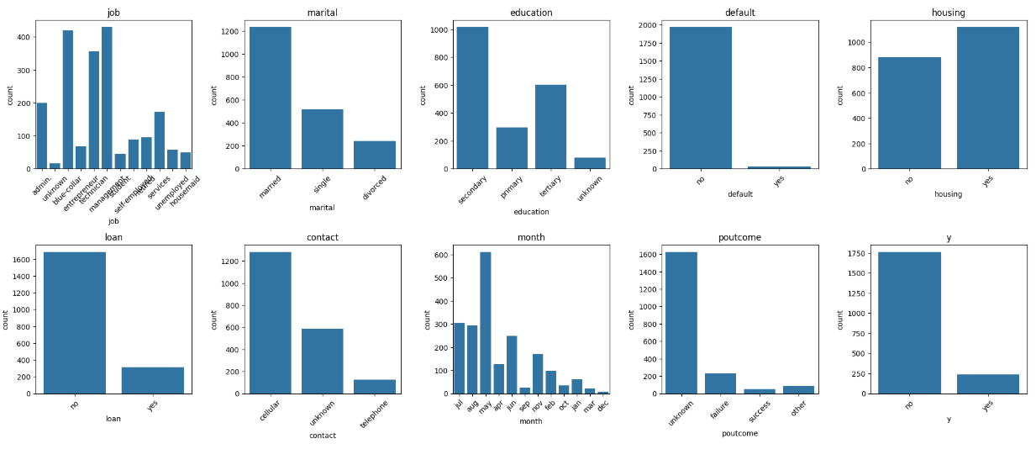
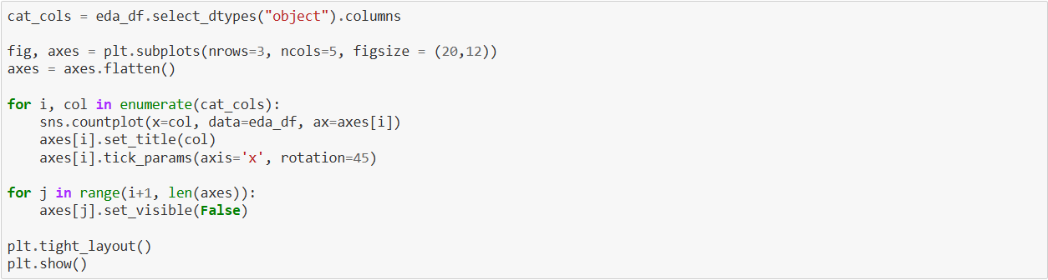

Slide 9
Inbalanced Features and Y
Now let's see the correlation between categorical features and y using Cramér's V method
Cramér’s V is an effect size measurement for the chi-square test of independence. It measures how strongly two categorical fields are associated.
The target column (y) ise imbalanced. There are too few examples of the minority class (in this case "yes") for a model to effectively learn the decision boundary.
To fix it, we'll oversample the examples in the minority class. SMOTE (Synthetic Minority Oversampling Technique) is the approach we use.

Slide 10
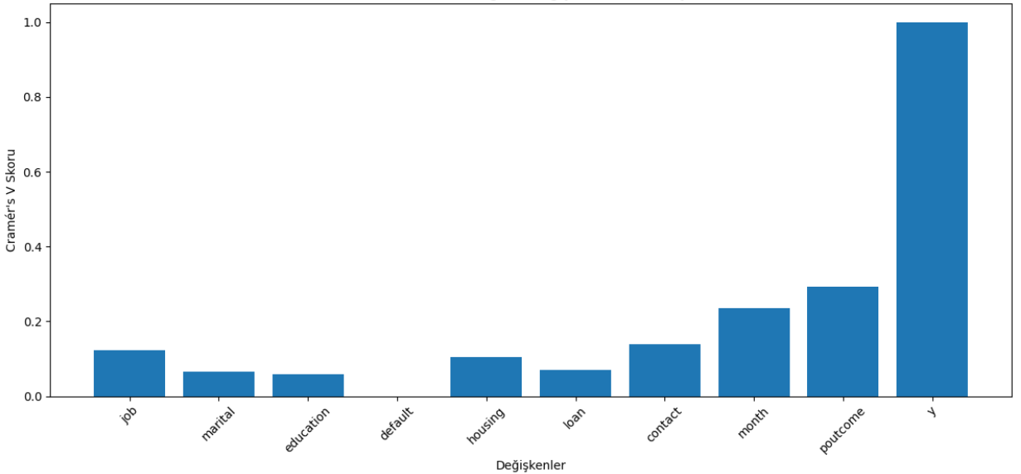
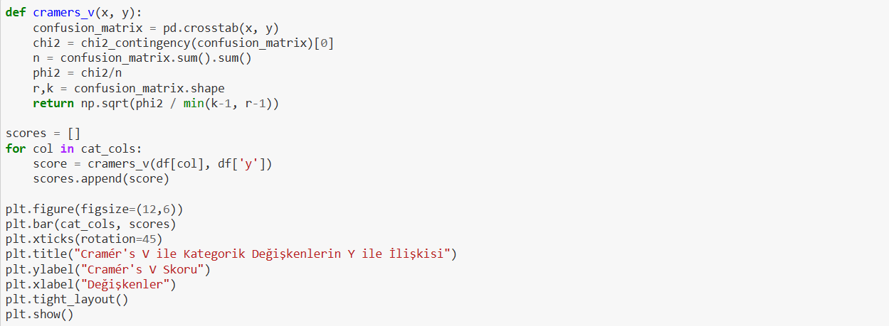
Correlation of categorical changes with Cramér's V and Y

Slide 11
In real world, default rate is crucial. The default rate is the percentage of outstanding loans a lender writes off as unpaid after a prolonged period of missed payments. However, in this case, it doesn't have a significant role.
Recall that almost every data point in the default column was "no", which indicates a highly imbalanced distribution. As a result, this feature lacks variability and does not contribute meaningful information for modeling or prediction.
So, we'll drop that column.

Slide 12
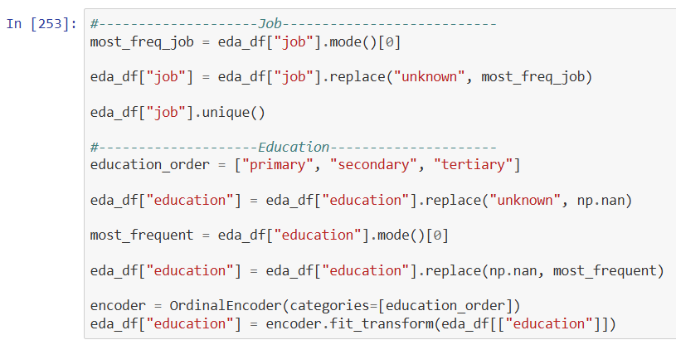
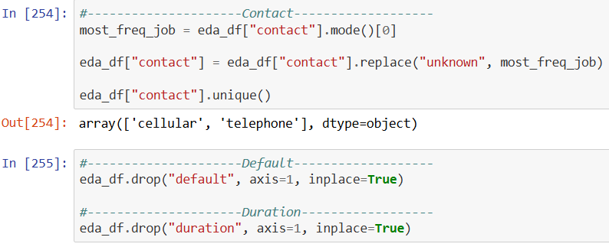
Let's make our categorical columns numeric
Since most of the poutcome column is "unknown" we may drop that column but as we saw earlier it has a role in output. We prefer to keep it, without changing it

Slide 13
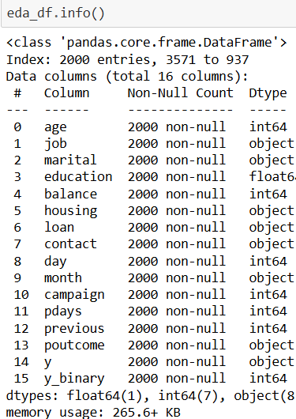
Great. There is no missing value. Sometimes, somehow, it happens

Slide 14
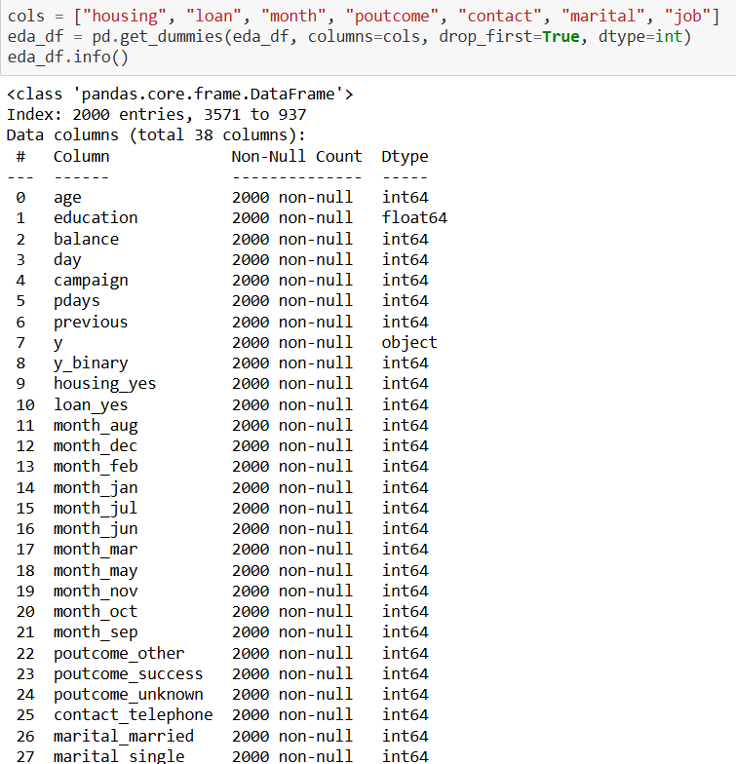
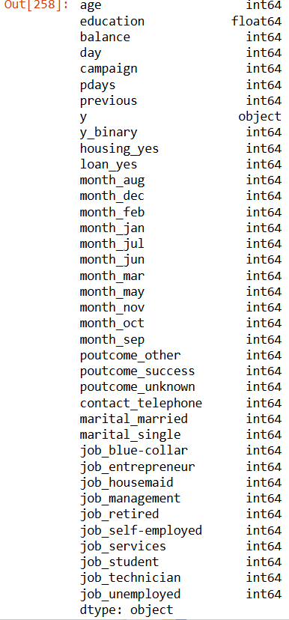
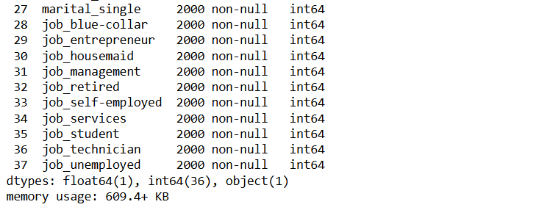
Since our numeric columns have different ranges (for example, age and balance), we prefer to use StandardScaler to normalize the data and ensure that all features contribute equally to the model performance.
Also, we drop the y column since we already have y_binary

Slide 15
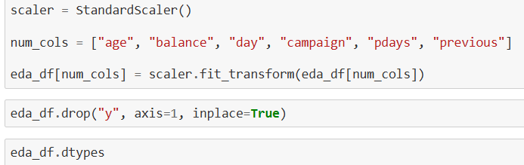

Slide 16
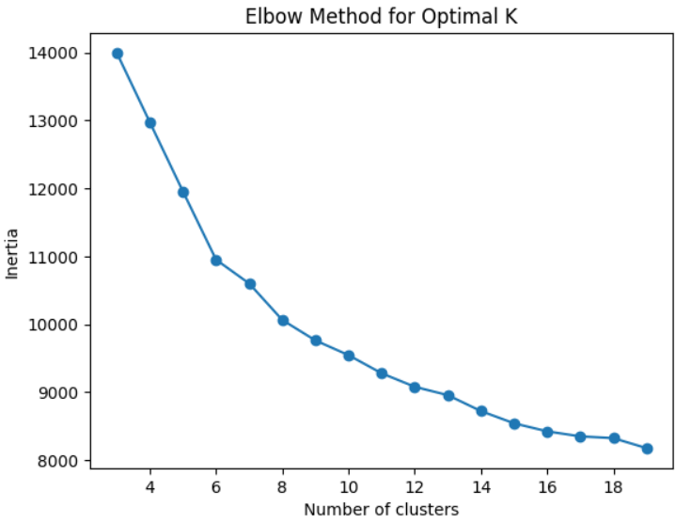
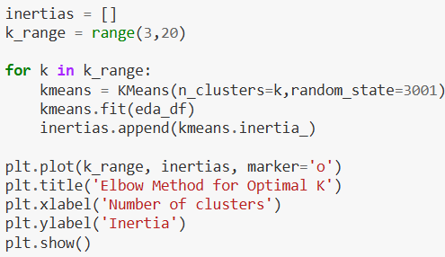
Clustering
We use the KMeans algorithm to cluster our data into distinct groups based on their features

